Slide 1

CHAPTER 9
COUNTING AND PROBABILITY
Copyright © Cengage Learning. All rights reserved.

Slide 2

9.6
r-Combinations with Repetition Allowed
Copyright © Cengage Learning. All rights reserved.

Slide 3
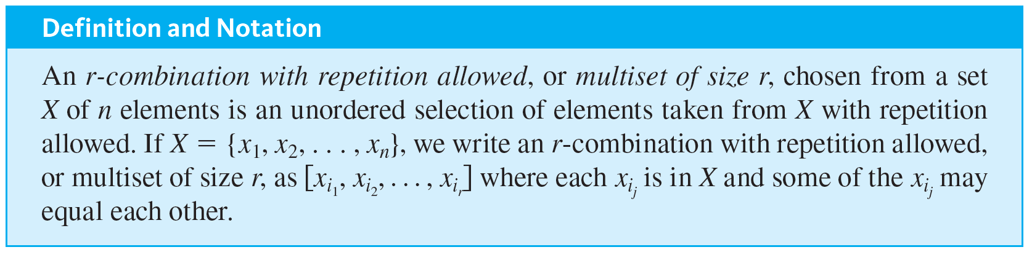
r-Combinations with Repetition Allowed
In this section we ask: How many ways are there to choose r elements without regard to order from a set of n elements if repetition is allowed? A good way to imagine this is to visualize the n elements as categories of objects from which multiple selections may be made.

Slide 4
Example 9.6.1 – r-Combinations with Repetition Allowed
Write a complete list to find the number of 3-combinations with repetition allowed, or multisets of size 3, that can be selected from {1, 2, 3, 4}.
Observe that because the order in which the elements are chosen does not matter, the elements of each selection may be written in increasing order, and writing the elements in increasing order will ensure that no combinations are overlooked.

Slide 5
Example 9.6.1 – Solution
[1, 1, 1]; [1, 1, 2]; [1, 1, 3]; [1, 1, 4]
all combinations that start with 1, 1
[1, 2, 2]; [1, 2, 3]; [1, 2, 4];
all additional combinations that start with 1, 2
[1, 3, 3]; [1, 3, 4]; [1, 4, 4];
all additional combinations that start with 1, 3 or 1, 4
[2, 2, 2]; [2, 2, 3]; [2, 2, 4];
all additional combinations that start with 2, 2

Slide 6
Example 9.6.1 – Solution
continued
[2, 3, 3]; [2, 3, 4]; [2, 4, 4];
all additional combinations that start with 2, 3 or 2, 4
[3, 3, 3]; [3, 3, 4]; [3, 4, 4];
all additional combinations that start with 3, 3 or 3, 4
[4, 4, 4] the only additional combination that starts with 4, 4.
Thus there are twenty 3-combinations with repetition allowed.

Slide 7
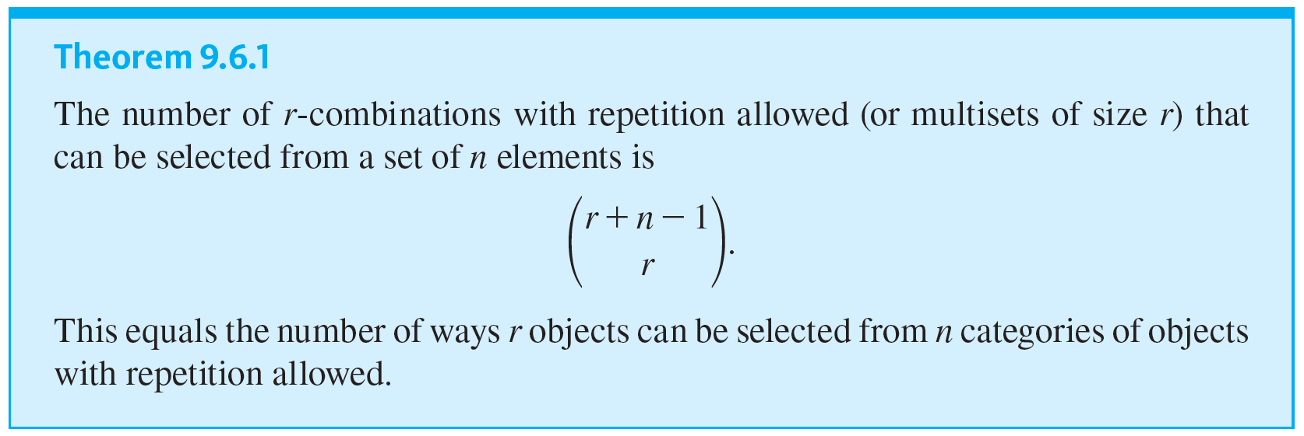
r-Combinations with Repetition Allowed

Slide 8
Example 9.6.2 – Selecting 15 Cans of Soft Drinks of Five Different Types
A person giving a party wants to set out 15 assorted cans of soft drinks for his guests. He shops at a store that sells five different types of soft drinks.
a. How many different selections of cans of 15 soft drinks can he make?
b. If root beer is one of the types of soft drink, how many different selections include at least six cans of root beer?
c. If the store has only five cans of root beer but at least 15 cans of each other type of soft drink, how many different selections are there?

Slide 9
Example 9.6.2 – Solution
a. Think of the five different types of soft drinks as the n categories and the 15 cans of soft drinks to be chosen as the r objects (so n = 5 and r = 15).
Each selection of cans of soft drinks is represented by a string of 5 − 1 = 4 vertical bars (to separate the categories of soft drinks) and 15 crosses (to represent the cans selected).

Slide 10
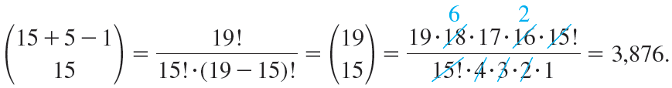
Example 9.6.2 – Solution
continued
For instance, the string
represents a selection of three cans of soft drinks of type 1, seven of type 2, none of type 3, three of type 4, and two of type 5.
The total number of selections of 15 cans of soft drinks of the five types is the number of strings of 19 symbols, 5 − 1 = 4 of them
and 15 of them

Slide 11


Example 9.6.2 – Solution
continued
b. If at least six cans of root beer are to be included in the selection, you can imagine choosing six such cans first and then choosing nine additional cans. The choice of the nine additional cans can be represented as a string of 9
For example, if root beer is type 1, then the string
represents a selection of three cans of root beer (in addition to the six chosen initially), none of type 2, two of type 3, four of type 4, and none of type 5.

Slide 12
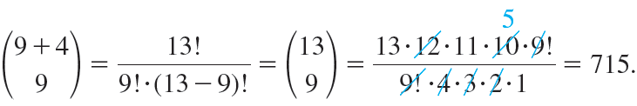
Example 9.6.2 – Solution
continued
Thus the total number of selections of 15 cans of soft drinks of the five types, including at least six cans of root beer, is the number of strings of 13 symbols, 4 (= 5 − 1) of them
and 9 of them
c. If the store has only five cans of root beer, then the number of different selections of 15 cans of soft drinks of the five types is the same as the number of different selections that contain five or fewer cans of root beer.

Slide 13
Example 9.6.2 – Solution
continued
Let T be the set of all possible selections assuming that there are at least 15 cans of each type, let R_{≤5} be the set of selections from T that contain five or fewer cans of root beer, and let R_{≥6} be the set of selections from T that contain six or more cans of root beer.
Then

Slide 14
Example 9.6.2 – Solution
continued
By part (a) N(T) = 3,876 and by part (b) N(R_{≥6}) = 715. Thus, by the difference rule,
N(R_{≤5}) = N(T) − N(R_{≥6}) = 3,876 − 715 = 3,161.
So, when there are only five or fewer cans of root beer, the number of different selections of soft drinks is 3,161.

Slide 15
Example 9.6.3 – Counting Triples (i, j, k) with 1 ≤ i ≤ j ≤ k ≤ n
If n is a positive integer, how many triples of integers from 1 through n can be formed in which the elements of the triple are written in increasing order but are not necessarily distinct?
In other words, how many triples of integers (i, j, k) are there with 1 ≤ i ≤ j ≤ k ≤ n?

Slide 16
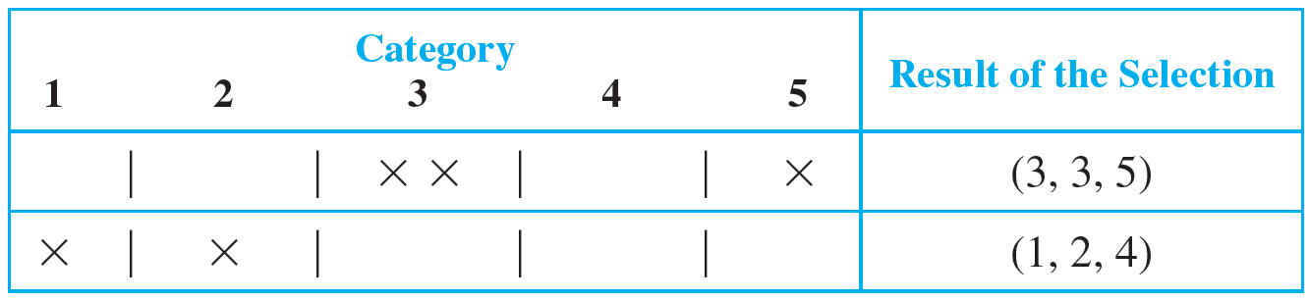
Example 9.6.3 – Solution
Any triple of integers (i, j, k) with 1 ≤ i ≤ j ≤ k ≤ n can be represented as a string of n − 1 vertical bars and three crosses, with the positions of the crosses indicating which three integers from 1 to n are included in the triple.
The table below illustrates this for n = 5.

Slide 17




Example 9.6.3 – Solution
continued
Thus the number of such triples is the same as the number of strings of
which is

Slide 18
Example 9.6.5 – The Number of Integral Solutions of an Equation
How many solutions are there to the equation
x₁ + x₂ + x₃ + x₄ = 10
if x₁, x₂, x₃, and x₄ are nonnegative integers?

Slide 19
Example 9.6.5 – Solution
Think of the number 10 as divided into ten individual units and the variables x₁, x₂, x₃, and x₄ as four categories into which these units are placed.
The number of units in each category x_{i} indicates the value of x_{i} in a solution of the equation.
Each solution can, then, be represented by a string of three vertical bars (to separate the four categories) and ten crosses (to represent the ten individual units).

Slide 20
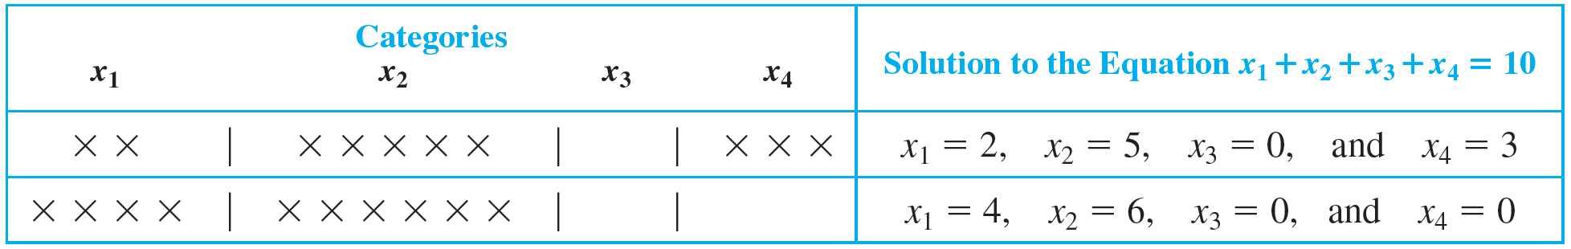
Example 9.6.5 – Solution
continued
For example, in the following table, the two crosses under x₁, five crosses under x₂, and three crosses under x₄ represent the solution x₁ = 2, x₂ = 5, x₃ = 0, and x₄ = 3.

Slide 21

Example 9.6.5 – Solution
continued
Therefore, there are as many solutions to the equation as there are strings often crosses and three vertical bars, namely,

Slide 22
Remark: Deciding Which Formula to Use

Slide 23
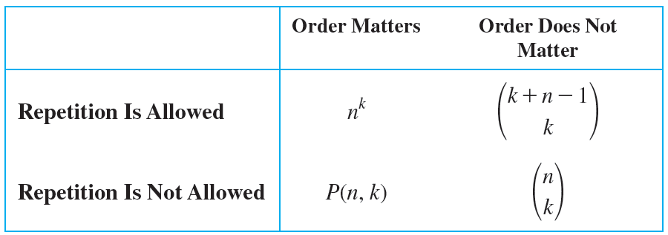
Remark: Deciding Which Formula to Use
Earlier we discussed four different ways of choosing k elements from n. The order in which the choices are made may or may not matter, and repetition may or may not be allowed. The following table summarizes which formula to use in which situation.

